Slide 1
The Hrishipara Daily Diaries
Tracking the money-management behaviour of low-income households in central Bangladesh
May 2015 - May 2016
Project managed by Stuart Rutherford and Md Kalimuddin
Thanks to CGAP for support
Notes:
Slides 1 – 9 are introductory (what are financial diaries?, basic facts about the Hrishi diaries). Slides 10 – 18 illustrate patterns seen in the diary data selected to provoke thought. Slides 19 -22 highlight a few ideas we can chew on in the brainstorming session

Slide 2
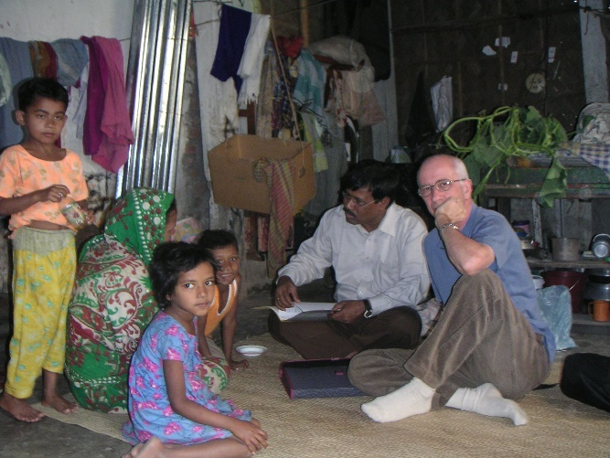
Financial Diaries
Financial Diaries: a research methodology that collects data about, and provides insights into, how people manage money.
The first Diaries were run in Bangladesh and India in 1999-2000, and in South Africa in 2004-2005.
Their purpose was to answer the question ‘do poor people have financial lives, and if so, what are they like?’
The results from these early diaries were described in the book Portfolios of the Poor. The book helped deepen our understanding of the financial needs, preferences and behaviours of poor households, and to broaden the thinking and practice of microfinance.
Typically, financial diary projects:
Recruit from 40 to 300 selected respondents
Meet the respondents daily, weekly or twice-monthly
Run for 3 months up to 3 years
Record the value and purpose of each transaction, and note where, with whom, and how each transaction was made
Notes:
The answer to the initial question (do poor people have financial lives?) seems obvious now, but in the 1990’s MFIs and others often behaved as if poor people had no financial life other than loans from grasping moneylenders

Slide 3
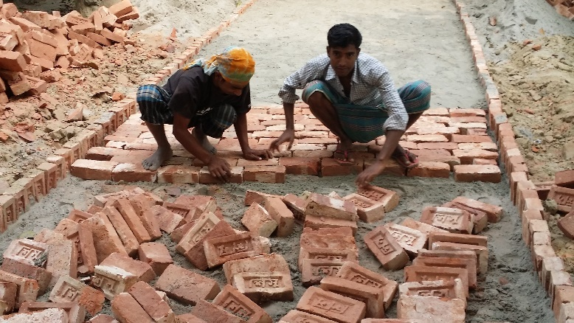
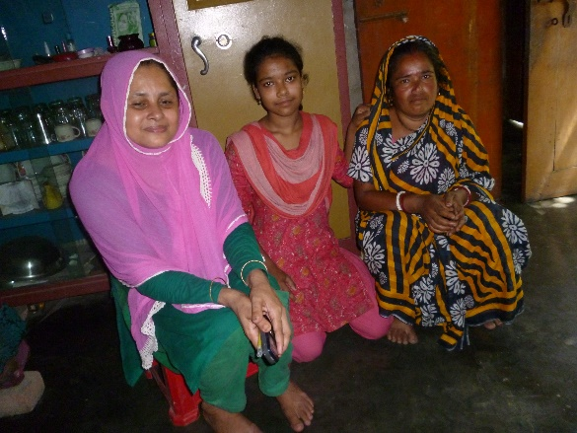
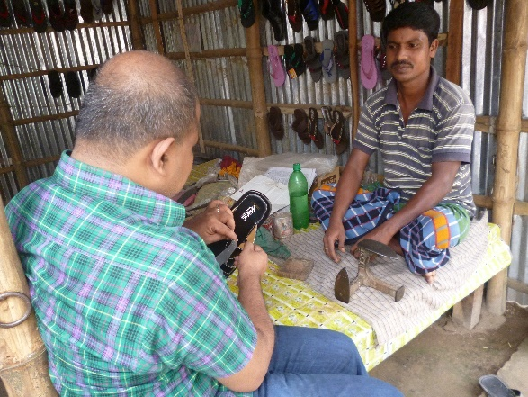
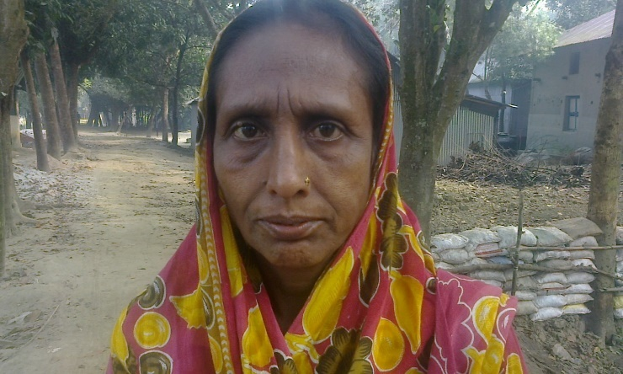
The Hrishipara Daily Diaries
Later diaries have researched more specific questions:
what is the role of digital finance in the lives of poor East Africans?
how do poor Indians finance their energy needs?
does microcredit harm poor women?
how do smallholder farmers around the world manage their livelihoods?
The Hrishipara Daily Diaries began as tool for Shohoz Shonchoy, a small experimental MFI based just outside Kapasia, Gazipur, to adapt its products to better fit its clients needs
When CGAP offered support, we broadened the objectives to learn more about:
the use of mobile-phone-enabled services
the financial lives of smallholder famers
the role of MFI services
Notes:
Explain that the sample was drawn from the general population around Kapasia, and not from Shohoz Shonchoy clients only

Slide 4
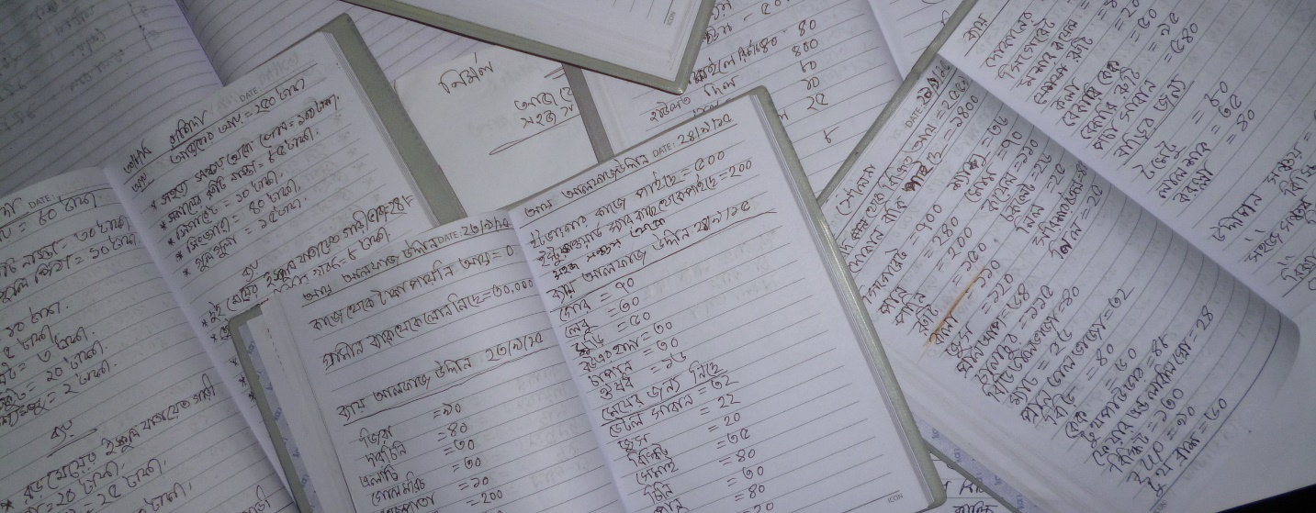
The Hrishipara Daily Diaries
First Diarists recruited mid-May 2015
By end May 2016:
106,500 transaction records comprising 750,000 data points
This is a work in progress: data collection will continue for several more months
What we present today is an interim look at the data so far
50 low-income households
All their money transactions recorded daily
All income and expenditure
All financial transactions (savings, loans etc)
All intra-household transfers
All gifts received and given
‘Baki’ (deferred payment) transactions separately tagged
Mobile phone-enabled transactions separately tagged
Data on ‘events’ also collected (any significant occurrence likely to have monetary consequences)

Slide 5
The Hrishipara Daily Diaries
Medium term target is to have 12 months of data for each of the 50 Diarists so that we can:
Say more about Seasonality
Make better Comparisons between income classes, occupational groups, gendered aspects of households
Better quantify and analyse financial behaviour
Pilot financial product improvements
50 low-income households
All their money transactions recorded daily
All income and expenditure
All financial transactions (savings, loans etc)
All intra-household transfers
All gifts received and given
‘Baki’ (deferred payment) transactions separately tagged
Mobile phone-enabled transactions separately tagged
Data on ‘events’ also collected (any significant occurrence likely to have monetary consequences)

Slide 6
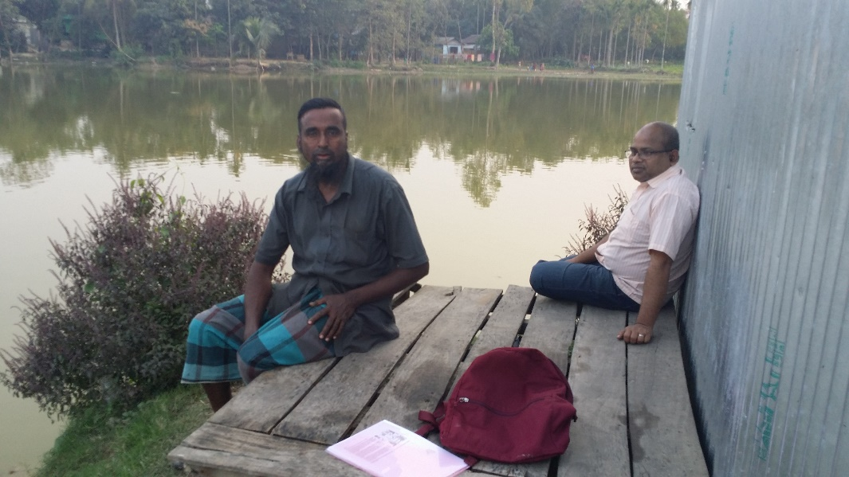
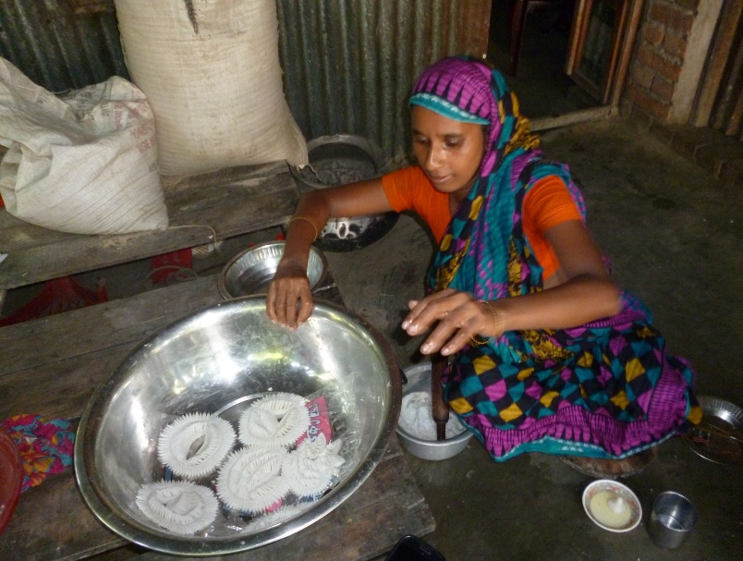
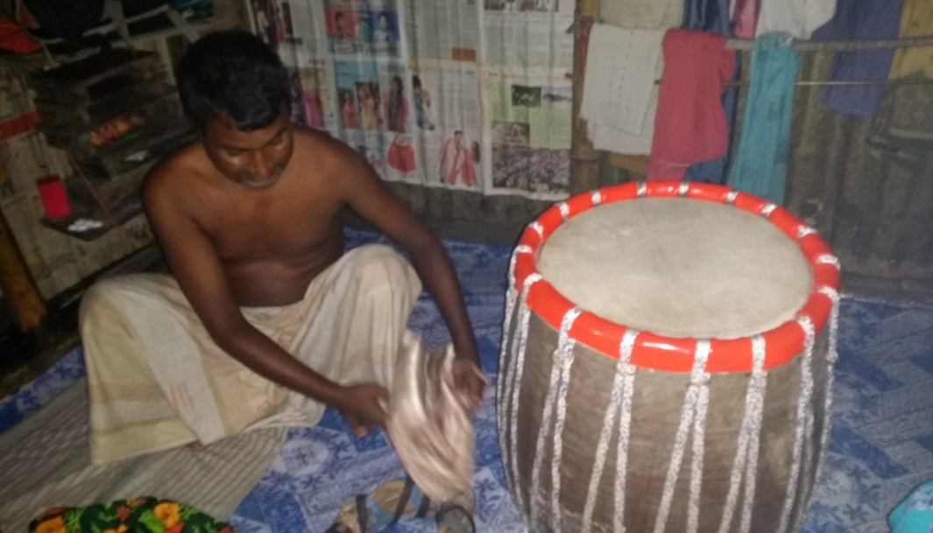
The Hrishipara Daily Diaries
Income levels of the 50 Diarists
11 Diarist households are ‘extreme poor’ (have daily per person incomes below taka 61.65, the Lower National Poverty Line)
9 Diarist households are ‘very poor’ (have daily per person incomes below taka 75.64, the Upper National Poverty Line)
10 Diarist households are ‘moderate poor’ (have daily per person incomes below double the formal GOB upper poverty line, taka 152 per person per day)
20 Diarist households are ‘near poor’ (above double the formal GOB upper poverty line, i.e. above 152 per person per day (they average 260)
*GOB set the lower poverty line at 42.90 Bangladesh taka in 2010, which is 61.65 in 2016 taka. The upper poverty line was set in 2010 at 52.64, or 75.64 in 2016 taka. This upper line figure is close the World Bank’s PPP$1.90 line.

Slide 7
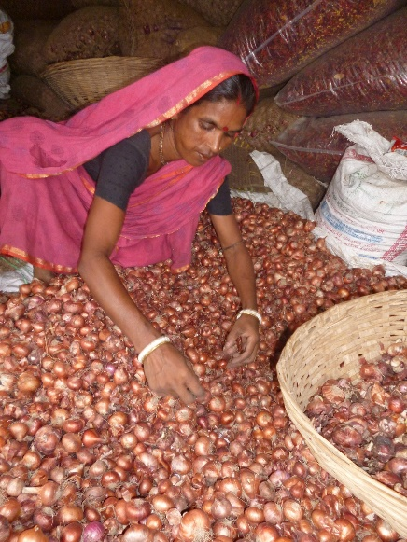
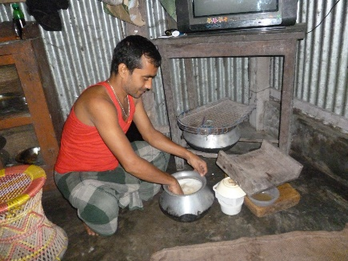
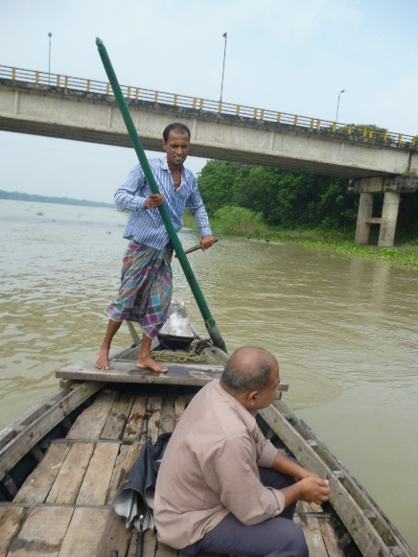
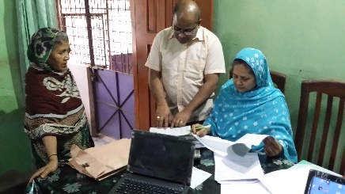
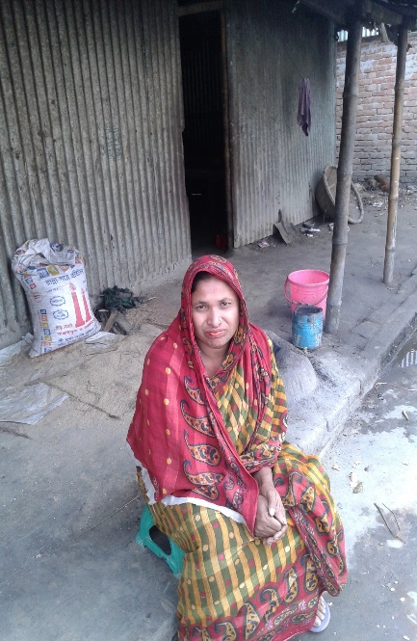
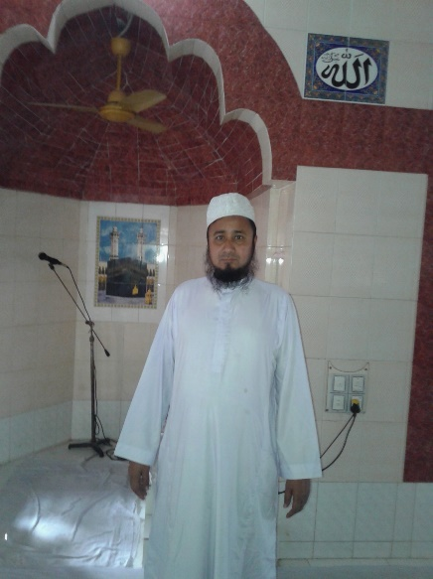
The Hrishipara Daily Diaries
Note the diversity here
Note the diversity here
the reported main occupation is not always the main income source
Notes:
Most have multiple sources of income: self-reported main occupation not necessarily the main source of income: ‘other’ include an Imam (pictured). ‘Diversity’ is a theme of the presentation (it means you can’t satisfactorily segment the financial services market by occupation or income class)

Slide 8
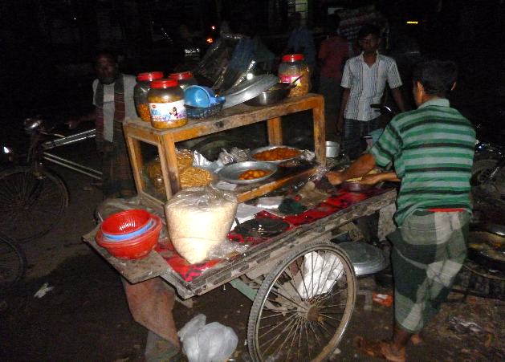
How might these data be used?
Consumption, labour and marketing studies
the diaries provide good data on:
Hours/day and days/week worked
Spending patterns by occupational and income class
Volatility of income
Seasonality of income and expenditure patterns
Count of expenditure records (business costs in italics) to end April 2016
e-Food 14,263
e-Treats and tobacco 6,668
e-Stocks for shops etc 5,935
te-Transfer to household 4,521
e-Transportation 1,972
e-Phones & airtime 742
e-Toiletries 721
e-Healthcare 596
e-Fuel 497
e-Farm inputs 495
e-Utilities 487
e-Home construction & repair 471
e-Clothes 347
e-Education 319
e-Fees 224
ge-Gift to outsiders 180
e-Newspaper stocks 160
e-Personal grooming 87
e-Rent 84
e-Vehicle repair 54
e-Misc spending 53
e-Worktools 46
e-Wages 41
e-Recycling material 28
e-Jewellery 25
e-Livestock 14
e-Real estate purchase 2
Values of leading expenditure classes
to end April 2016, taka
e-Home construction & repair - 1,714,913
e-Food - 997,544
te-Transfer to household - 325,664
e-Treats and tobacco - 235,521
e-Real estate purchase - 210,000
e-Utilities - 163,395
e-Healthcare - 149,752
e-Transportation - 142,875
e-Misc spending - 130,837
ge-Gift to outsiders - 121,926
e-Clothes - 114,944
e-Education - 87,708
e-Jewellery - 76,700
e-Rent - 75,735
e-Fuel - 49,517
e-Phones & airtime - 37,958
Daily earnings of a street snacks vendor, taka, Jan 1 – Apr 30 2016. income of 110 taka per person per day
Note low volatility
He took only one day’s rest
Notes:
Explain ‘We’’ll talk mostly about financial services today, but there are other areas where these data can be useful…’. Useful perhaps when planning to launch sales of ‘socially beneficially’ goods and services. There is considerable diversity among diarists in the level of volatility of income.

Slide 9
How might these data be used?
Social and personal services provision
the diaries provide good data on:
Health:
Patterns of health spending
Sources of health spending
Response time to illness or injury
Gender dimension of health treatment
Education:
Patterns of education spending
What happens and why when a child is out of school
Gender dimension of education spending
Per capita daily income 56 taka, extreme poor
Reacting to appendicitis
An incident seen in the context of the household economy
11 May 2016: 14 year old daughter of extreme poor shopkeeper reports severe pain
12 May: pain worsens, local medicine bought, loan taken to pay for it
15 May: pain extreme, Doctor visited. Appeals for financial help begin
19 May: promises of financial help given
20 May: financial help arrives, admission, operation, payment and daughter returns home
Medicine bought, loan taken
Doctor seen, advises quick operation
Gifts start to come in
Admission, operation, payment, release
Symptoms begin
All transactions over a 12 day period
Notes:
Here, take a moment to explain the chart set-up: horizontal axis is time, vertical is aggregated transaction value (inflows above the line, outflows below the line)

Slide 10
How might these data be used?
Financial services provision
the diaries provide particularly good data on:
Borrowing:
Interest-free from neighbours, family and employers
On interest from private sources
On interest from MFIs and Cooperatives
From local samitis (informal savings and loan clubs)
Saving:
Interest-bearing with banks, MFIs and insurance companies
With money-guards
In the home and on the person
Via lending to others
Via conversion to in-kind goods and jewellery
We also have records of consumer credit (baki), mortgaging (e.g. rehan) and pawning, and finance-related practices such as share-cropping and share-rearing.
What distinguishes our diary data from other research into financial tools and services is that we collect all the financial transactions of our Diarists, and do so across long periods of time.
Finance is the intersection of time and money. You cannot fully understand a household’s financial behaviour unless you look at both of these dimensions in tandem.

Slide 11
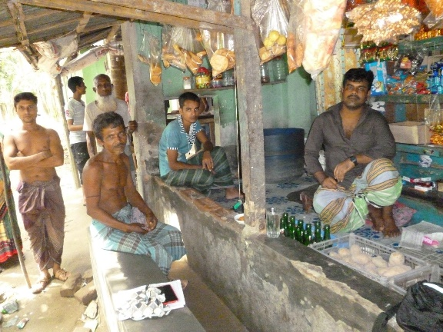
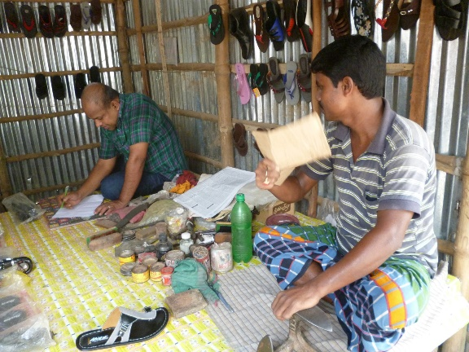
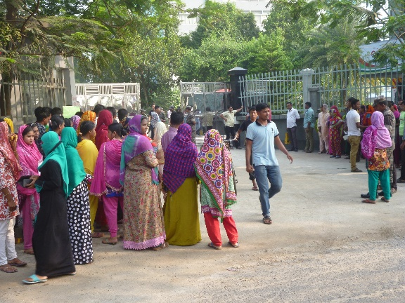
How might these data be used?
The day-by-day, multi-month view of how people actually use financial tools and services makes the diaries good at exploring long-standing questions about financial service provision and policy:
Assumptions such as: Poor people need to borrow continuously
MFI loans should be used only for income-generating activities
Farming income and sales are ‘lumpy’ and they need big balloon-repayment loans
Very poor people find it almost impossible to save
Claims such as:
MFI loans damage poor households
MFI loans propel poor people out of poverty
Poorly understood issues such as:
Attitudes to borrowing vis-à-vis saving
The quality and utility of local samitis
Why do insurance and pensions remain almost unobtainable for the poor?
Product design issues such as:
Should MFI loans stick to one-year terms and strict weekly repayments?
Notes:
Offer the audience a chance to add to this list…..

Slide 12
Transaction patterns: means of exchange
Cash still dominates
Mobile phone use:
40 of the 50 Diarists own their own phone
of these, 9 are smartphones
Another 6 have access to a phone at home
14 say they opened a bKash or Dutch Bangla account
but we found mobile phone-enabled transactions for only 9 of them
Heaviest users are migrant working men sending money back to the village
All transactions
Mobile phone-enabled:
By value of transactions, 1.05% of total
By count of transactions, 0.21% of total
wages
Notes:
Phone ownership is growing fast. The current very low level of mobile-enabled transactions doesn’t imply that things won’t change. But the majority of Diarists see no reason to use the key mobile service – money transmission - telling us ‘I never have any need to send or receive money from afar’, and most have other ways to save and borrow

Slide 13
Transaction patterns: small and frequent
Small shopkeeper, sales and stock purchases, Feb/Mar/Apr 2016, daily, taka
Bengali New Year
70 taka income per person per day, very poor
Farmer, farm sales and farm inputs, Feb/Mar/Apr 2016, daily, taka
Notes:
All our farmers exhibit this ‘little and often’ purchases and sales, though sometimes some of them also make lumpy sales (post-harvest or selling big livestock). This may not be true in less densely populated areas of Bangladesh.

Slide 14
Transaction patterns: finance is important
Relationship between economic and financial flows
% composition of total transaction values, all Diarists, first quarter 2016
inflows outflows
Financial flows exceed income-and-expenditure flows in the quarter, by 7.29 million taka to 6.93 million.
The financial flow values in the chart reflect the transactions made by diarists and therefore exclude cash reserves deposited in the home.
Baki (deferred payment) transactions are recorded in our data as expenditure flows, not as financial flows.
If cash deposited in the home and baki payments were treated as financial flows, the share of financial flows would be considerably greater
Notes:
So for every taka our Diarists earn or spend, they push just over a taka through savings or loan services or devices: this reinforces my view (reflected in later slides) that the ‘big’ place to look for product innovation and improvement is in basic intermediation

Slide 15
Transaction patterns: financial diversity
Small shopkeeper A, sales and stock purchases, loans and repayments, Aug 2015 to Apr 2016, weekly, taka
Small shopkeeper B, sales and stock purchases, loans and repayments, Aug 2015 to Apr 2016, weekly, taka
Large loans from MFIs
Small loans are local ‘howlats’
Notes:
Key slide on ‘diversity’. Shopkeeper A takes virtually no loans, doesn’t need them, buying stock daily out of daily sales and a small cash reserve. He is prospering. Shopkeeper B has got into a loan trap. She too buys most of her stock from daily sales and the bulk of hger loans go into repaying other loans. She is under considerable stress. So DON’T treat them the same!

Slide 16
Transaction patterns: financial diversity
Indebted labouring household, financial transactions, weekly to March 2016, taka
Per capita daily income 60 taka, extreme poor
The household took a private loan on interest some months back
They then took an MFI loan to help pay off the private loan
They have trouble finding the weekly MFI loan repayments and take howlats to help them pay
MFI repayments
Local ‘howlats’ to help cover MFI repayments
Per capita daily income 26 taka, poorest Diarist
Casual woman labourer, financial transactions, weekly to March 2016, taka
Earns very little from casual work in the market but avoids debt
Is able to save 10 taka almost every day
Has built up a cushion of savings
Sometimes, it is money management rather than income that determines the shape of household poverty
Notes:
Another key ‘diversity’ issue slide. The poorer household, avoiding loans, is able to save and has built up a cushion. The better-off household has fallen into a loan trap. They need rescuing. Hence the importance of ‘P9’ type products. Don’t treat them the same!

Slide 17
Transaction patterns: the vital role of gifts
Female casual labourer: all daily transactions for the month following the death of her husband
Withdrawal of some of her savings
Gifts from well-wishers
Bulk of savings shifted from short-term to DPS
Surplus gifts put into improved housing
As we saw with the appendicitis case, gifts from neighbours, family and employers remain an important response to rapid-onset emergencies
Notes:
Gifts always seem to emerge when a major event (death, serious illness) occurs. Note that the gifts are supplemented by savings withdrawals rather than loans. There is a general expectation of reciprocity.

Slide 18
Transaction patterns: savings and loan balances
Savings at MFIs and banks, and debt at MFIs, taka, 38 diarists arranged by per capita daily income
39 of our 50 Diarists hold accounts at MFIs (usually more than one MFI)
The extreme poor are the least likely to hold an MFI account
In all income classes savings are greater than debt
The main vehicle for large MFI savings is the DPS
So what happened to the 39th Diarist?
Their combined formal savings exceed their combined MFI debt by 2.5 to 1
Notes:
Key slide on MFIs. They have been transformed from lenders to the very poor into trusted holders of low-to-middle income household savings. They must seen, regulated, linked, and made to behave responsibly as such.

Slide 19
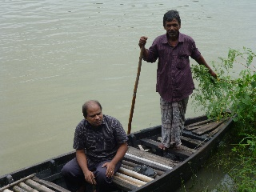
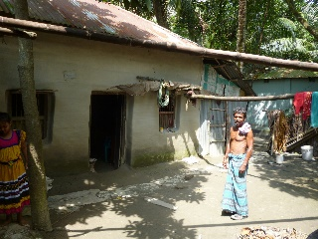
Transaction patterns: financing a big expenditure
Fisherman: all transactions, daily for a month, as he manages his daughter’s marriage, taka
January 4:
Withdraws 5,000 from wife’s 3rd MFI, (PIDIM)
January 4:
Withdraws 23,000 from his money-guard
January 10:
Wife gets MFI SSS to lend her 35,000
Gifts from wedding guests
December 25:
Spots the marriage chance
January 4:
sells his wife’s gold and has it made into new jewellery for bridegroom……
December 30:
Withdraws 5,000 from wife’s first MFI, (Al Arafa)
January 3 and 4:
Withdraws 10,000 and 7,500 from wife’s 2nd MFI, (SSS)
January 17:
Further 30,000 dowry payment
January 4:
Takes jewellery and 20,000 dowry to bridegroom’s home
The marriage was financed by: MFI savings (15%), private savings (12%); sale of jewellery (32%); an MFI loan (17%); and gifts from guests (24%)
Per capita daily income 180 taka, near poor
Notes:
Role of financial services and devices, above all savings, in paying for big occasions.

Slide 20
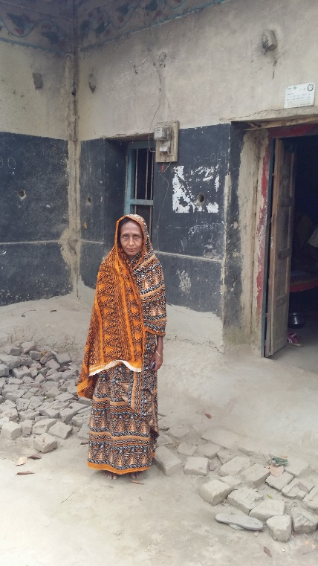
Transaction patterns: building a quasi-pension
Her financial transactions during the first quarter 2016
From an extreme-poor background, she was deserted by her husband
But her son got a job overseas and has remitted regularly for many years
Regular remittances from son abroad
She shifts a matured GPS into a fixed deposit
She has saved most of it using the GPS at Grameen Bank, where she now has a savings balance of 1.9 million taka ($PPP 33,000)
How the 39th Diarist saves for her old age
Regular deposits to GB GPS
An early client of Grameen Bank, her home was registered in her name when she took a Grameen housing loan, so she kept it when she was deserted.
Per capita daily income 490 taka, near poor (big remittance income and only two people in the household)
Notes:
A question is, could she have done better with more specific tools for her pension savings? A GPS is Grameen Bank’s version of the DPS (Deposit Pension Savings) a popular product of the formal banks.

Slide 21
Ideas to chew on: MFIs and savings
MFIs have become the principal guardians of the savings of the poor and the near-poor
Having started with the ambition to reach the ‘poorest of the poor’, MFIs now reach far more upper- and near-poor users
This gives them, and their regulators, new opportunities and new duties
Low-income Bangladeshis, having been diverted into too much borrowing during the heady early years of microcredit, are now reverting to international norms and saving more than they borrow
One opportunity: pilot ways to gear-up some of the undifferentiated mass of savings into poor-friendly specific instruments: above all insurance, maybe pensions
She should be helped to maximise the power of her savings
Her neighbours should be helped to follow her example
Two good ways to learn from the poor:
1: observe what they do themselves
2: observe how they respond to pilots
The first approach is exemplified by Financial Diaries, the second by experimental products like P9
Once MFI accounts are modernized they might act as low-cost pathways to insurance cover (or even public/private pension provision)
Notes:
P9 is a pilot scheme at Shohoz Shonchoy aimed at helping people to borrow less and save more.

Slide 22
Ideas to chew on: better MFI loans
Microcredit began with a focus on a particular market segment: poor women entrepreneurs
However, MFIs now serve a massive market, including many near-poor and non-poor clients
MFIs should choose:
Either continue with a ‘port-manteau’ product but make it much more flexible
Serving this market with a highly standardised loan product has become unsatisfactory for many users
Inflexible terms, inflexible repayment schedules, obligation to borrow continuously, no small loans any more
Or embrace technology to provide a truly individualized service
Merely segmenting the market by occupation or income class is dangerous
Our shopkeeper examples show how easily MFIs can throw users into over-indebtedness
Among our Diarists, financial transactions exceed income and expenditure transactions. Managing finance is an enormously important part of their lives. Serching for innovations and improvements should prioritise basic intermediation processes.
Notes:
One of the key ideas about ‘basic intermediation’

Slide 23
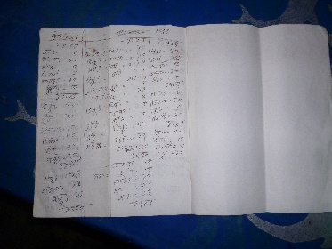
Ideas to chew on: monitoring devices
Several Diarists commented that do the diaries helped them understand their cash flows better (some asked for copies of their records)
For baki management by small shopkeepers
A smartphone app simple enough to compete with the basic notebooks used at present. Maybe using images of banknotes that can be dragged onto or off of photos of the customer.
For MFI account management
Many Diarists have multiple MFI accounts, and are confused. A manual or digital way of recording MFI loan and savings balances and payments due maybe a good way for MFIs to return value to customers.

Slide 24
Ideas to chew on: touch points
‘Touch points’ are places or activities that people regularly visit or perform, that could act as pathways to key services.
Examples might include:
Airtime and insurance
80% of the Diarists own mobile phones. Their frequent airtime purchases (linked to their ID via their registered sim) could become sales points for discrete packages of health insurance
Goldsmiths and insurance
Several Diarists bought gold with an eye on future security, making goldsmiths a good outlet for insurance products.

